Slide 1

Internet & WWW
CSE 309: Web Applications & Internet
Fall 2018
By Shama Hoque
Lecture 2

Slide 2
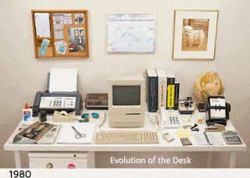
Lecture Outline
History of Internet & WWW
How the Internet works
Web application architectures
Design Patterns (MVC)
Reading for this lecture:
The World Wide Web: Past, Present and Future (1996) - Tim Berners-Lee
MDN: How does the Internet work?
MDN: How the web works
Ch 8.1 Dynamic Web Applications (pg 201 - 203) from Web Application Architecture by Leon Shklar & Richard Rosen
JavaScript MV* Patterns from Learning JavaScript Design Patterns by Addy Osmani

Slide 3
Internet & Web Timeline
Amazon EC2
Intelligent Web &
Amazon
Internet of Things (IoT)
First computer
(ENIAC)
Facebook
Mobile Web
shift
Internet Protocols
(TCP/IP)
JavaScript
Ajax
World Wide Web
HTML5
ARPANET
Google
First Browser
Responsive
Design
First e-mail
}
HTTP
}
}
}
ES6
ES7
ES8
}
}
1945
1970
1980
1990
2000
2010
2020
Military
Business
PC/Desktop
Web 1.0
Web 2.0
Web 3.0
Notes:
Internet & Web timeline
1945 - 1970: Computing inception and use in military.
First computer, the ENIAC was developed at University of Pennsylvania in the 1940s. Initially, computers were mostly used for military purposes. History of the internet is closely tied to the history of computing.
ARPANET - a pioneering network for sharing digital resources among geographically separated computers.
It was the precursor to the internet, developed to be highly distributed intended to survive a nuclear attack.
First e-mail program was developed on the ARPANET and became instantly popular amongst the staff.
1970 - 1980: Used in business.
The existing computers were very expensive for the general public. But the utility was recognized and during this era big corporations who could afford it, started using computers for things like accounting, payroll, and inventory.
1980 - 1990: Personal computers came to market, and were more affordable for the common man. (The birth of the IBM PC)
PCs available were primarily used for simple applications like word processing, spreadsheets. As more people started using a computer, this developed an ecosystem of PCs. During this the TCP/IP protocols were developed to standardize communication between networked devices, and these protocols are still in use today.
During the end of this era, Tim Berners-Lee at CERN conceived the notion of the World Wide Web with the purpose of sharing knowledge worldwide. He also created the first website and web server.
1990 - 2000: Web 1.0 and Dot-com Era.
This era saw a boom in internet use, mostly static websites grew in numbers and there was a lot of hype around Internet based
companies, leading to the Dot-com bubble and eventual crash in the stock market. Companies like Amazon and Google started.
1992 - HTTP protocol developed
1993 - Mosaic (a popular browser by Netscape) that accelerated internet traffic
1993 - only 600 websites on the WWW
1994 - 10,000 websites
1996 (Jan) - 100,000 websites
2000 - 2010: Web 2.0
Web sites became more interactive, collaborative and dynamic. Software was becoming more ubiquitous, and was no longer limited to the restrictions of hardware or OS. Websites can be accessed anywhere on any computer or device. Mobile devices started getting access to the internet. Amazon EC2 was launched to the world, beginning the rise of cloud computing.
2010 - 2020: Web 3.0 & Future
2012 - 634 million websites on the web and ecommerce sales topped 1 trillion dollars worldwide
2013 - 4 billion web pages in the indexed web
2014 - Year of responsive design: HTML5
Mobile apps accounted for more than half the time people spent viewing and using digital content. Number of mobile connected devices
exceeded the number of people in earth.
We are in the internet revolution and moving to an era where everything is connected via the internet. Even appliances, cars, homes will
become connected in the Internet of Things (IoT). Also emerging is the idea of the Intelligent Web (intelligent recommendations,
suggestions based on user activity and history. Example, suggestion on youtube or recommendations on Amazon)

Slide 4
How does the Internet work?

Slide 5
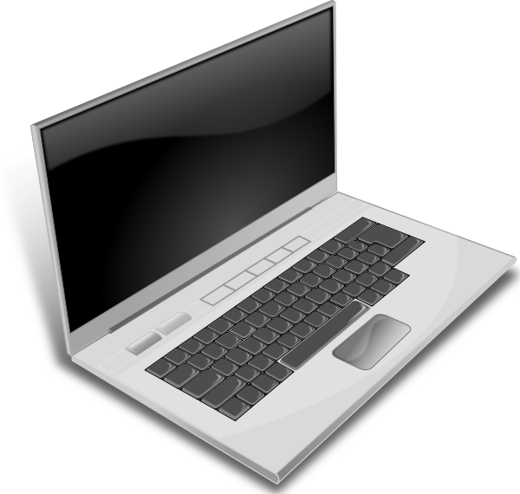

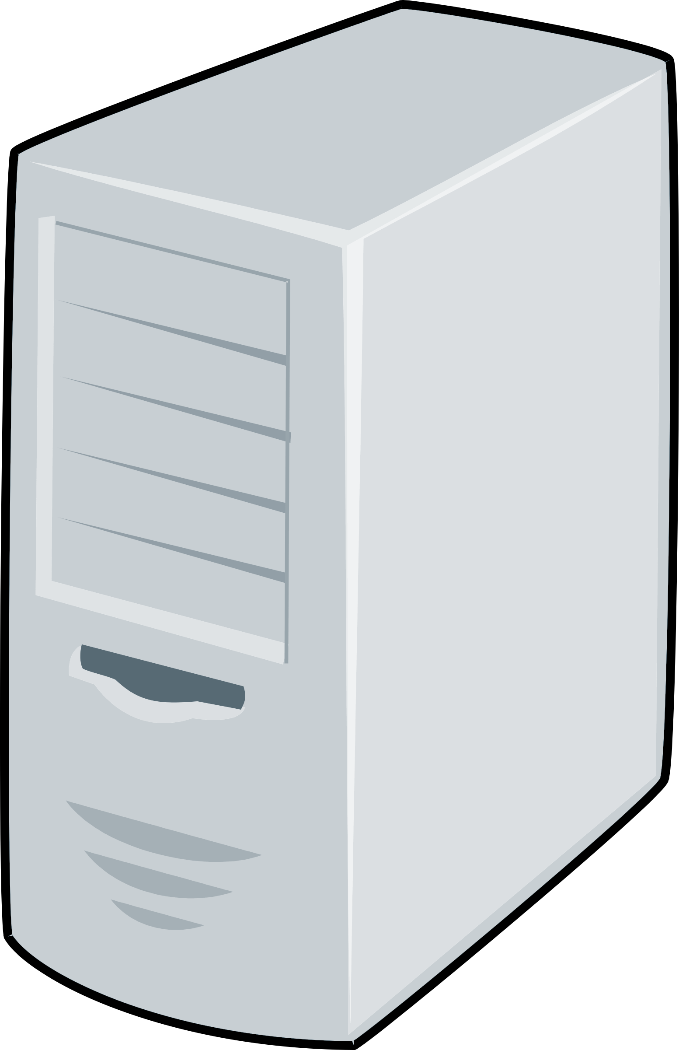
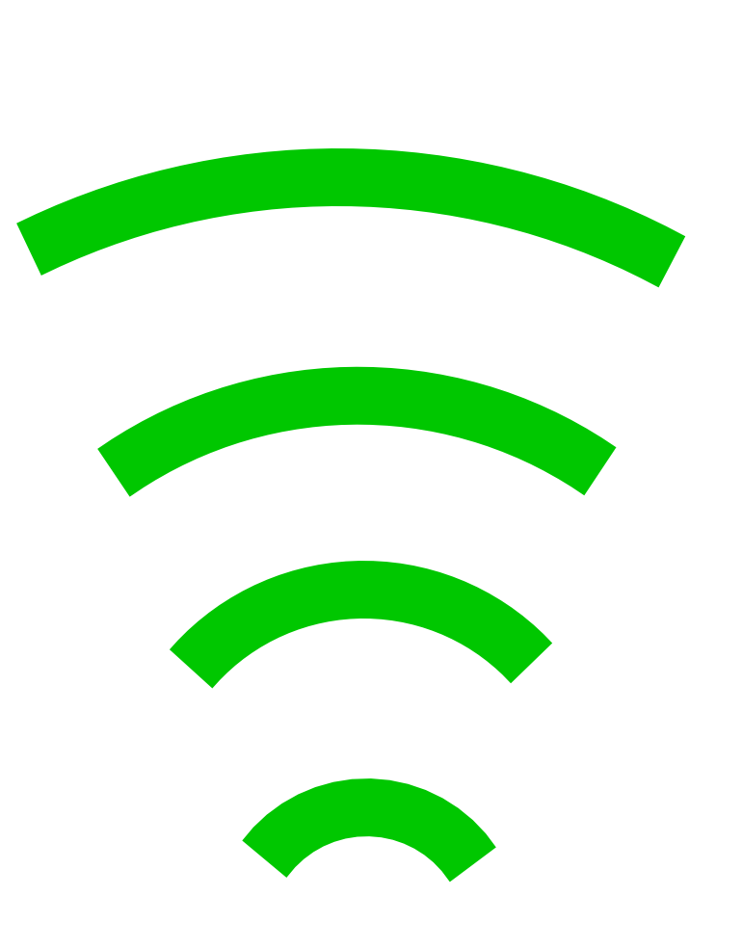
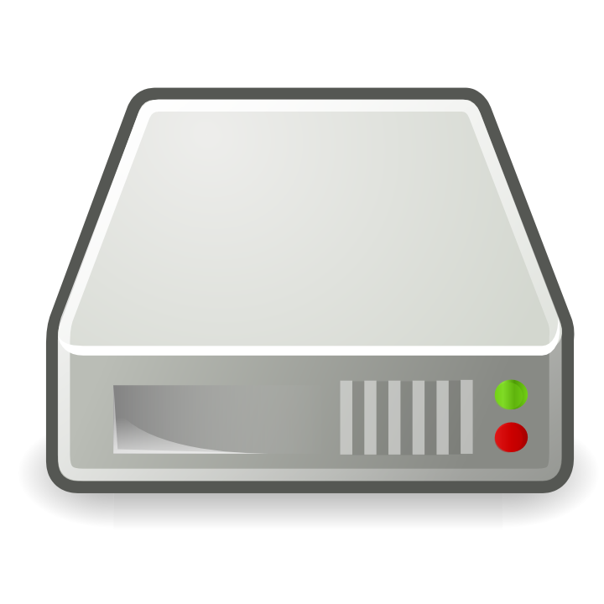
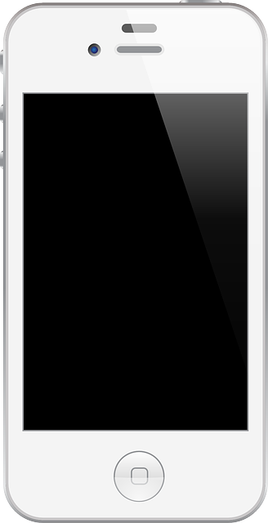
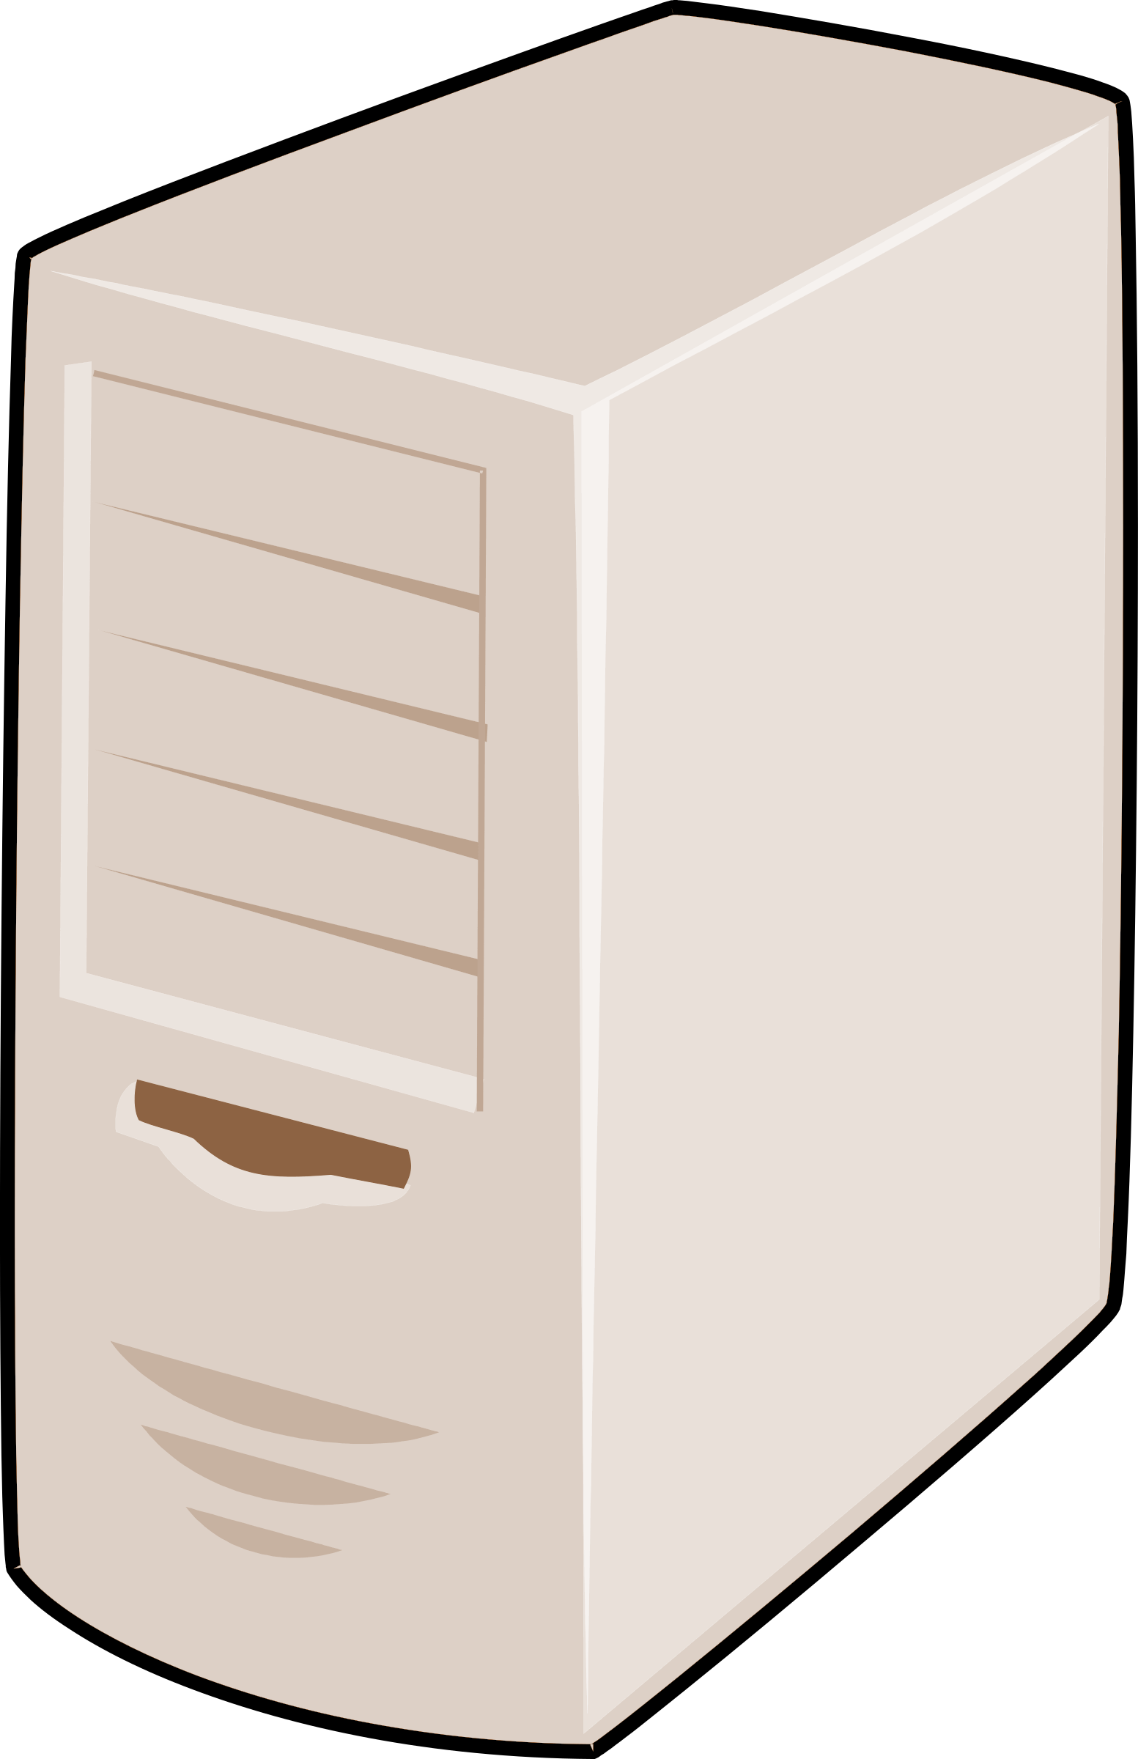
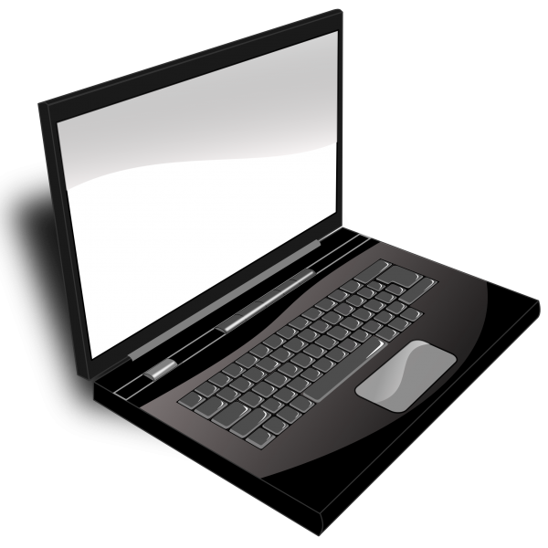
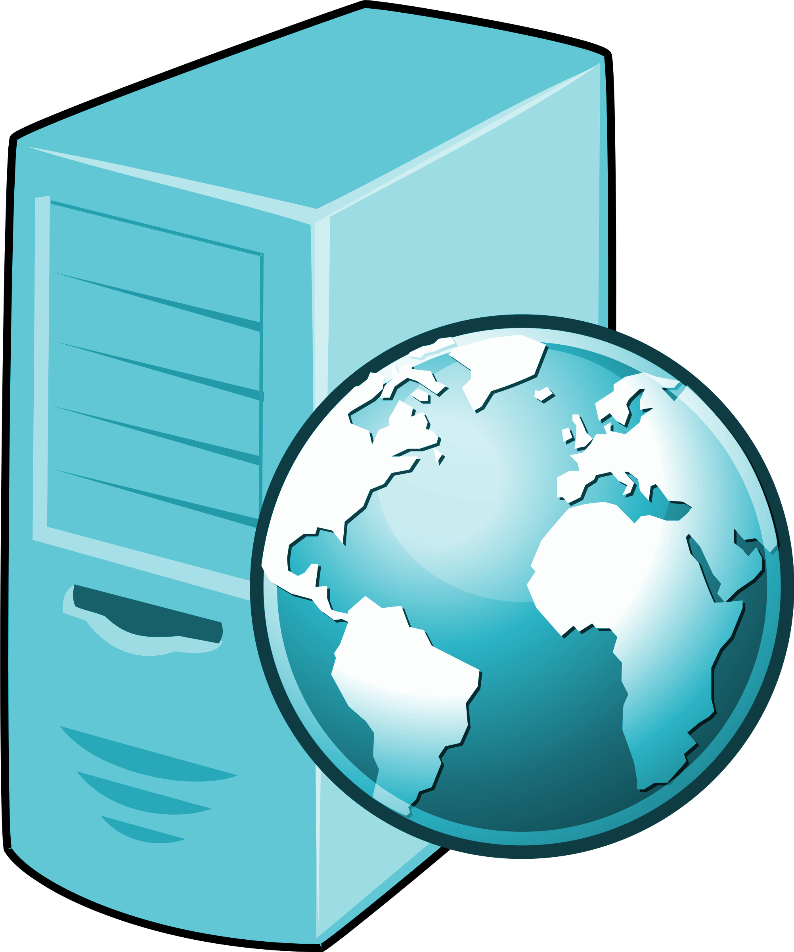
IP Address:
129.64.137.22
IP Address:
129.64.137.23
Domain Name:
www.google.com
Client
Client
IP Address:
64.233.171.1
Router
Server
IP Address:
129.64.137.34
ISP
Internet Backbone
Router
Router
Router
Router
TCP/IP
TCP/IP
TCP/IP
TCP/IP
IP Address:
109.34.130.20
www.google.com
Domain Name:
facebook.com
Client
ISP
IP Address:
66.220.144.1
DNS
64.233.171.1
Server
Notes:
What is the Internet? What does it do?
The Internet allows computers anywhere on the world to connect and communicate by transferring data between the computers.
The Internet backbone is just a massive collection of networks, there are literally millions of computers and millions of connections that make up this Internet backbone.
Our personal computers (clients) are not directly connected to the internet (unlike servers, servers host websites), clients generally connect to the internet through an Internet Service Provider (ISP). Between every two networks on the Internet there is a router to enable communication.
Communication between computers on the internet with data packets
Every device connected to the internet must have a unique IP address, for routing messages within the internet. An IP address uses 32 bits, or four 8-pin numbers. Let’s assume you want to connect to google.com to search, how does this communication work? Your computer, the client in this case has an unique IP address (i.e 109.34.130.20) and the server that hosts google.com also has an unique IP address (i.e. 64.233.171.1). Now, how does a message go from the client to the server? The router uses a protocol that's called TCP/IP, it breaks a message up into packets, and this packet has a source address (client IP address), it has a destination address (server IP address) and it has the the associated data. And these packets travel via many routers in the internet to get to the destination.
Domain names and IP addresses
IP addresses are heard to remeber, so instead domain names like google.com which is mapped to the IP address.
So, for example, if you want to go to the Google server, you type into the browser www.google.com. Now this has to get translated into the proper IP address. The way that happens is by using something called a domain name server, or DNS for short. And here are DNS servers all over the Internet, and what they do is simply map a given domain name to a given IP address. So when you type in www.google.com, it'll query your ISP most likely that has a DNS, domain name server attached to it, and the proper IP address will be returned allowing you to send a message to this server that's on the other side of the Internet some place.

Slide 6
TCP / IP
Networking Model
(Web App)
Protocols / Services
Application
DNS, HTTP
Transport
TCP
Internet
IP
Network Interface
Ethernet
(Networking Hardware)
Notes:
TCP/IP that is Transmission Control Protocol and Internet Protocol was developed by Department of Defence's Project Research Agency (ARPA, later DARPA) as a part of a research project of network interconnection to connect remote machines.
The features that stood out during the research, which led to making the TCP/IP reference model were:
Support for a flexible architecture. Adding more machines to a network was easy.
The network was robust, and connections remained intact until the source and destination machines were functioning.
The overall idea was to allow one application on one computer to talk to(send data packets) another application running on different computer.
The Network Interface layer (also called the Network Access layer) deals with all physical components of network connectivity between the network and the IP protocol. It is responsible for placing TCP/IP packets on the network medium and receiving TCP/IP packets off the network medium. TCP/IP was designed to be independent of the network access method, frame format, and medium. In this way, TCP/IP can be used to connect differing network types. These include LAN technologies such as Ethernet and Token Ring and WAN technologies such as X.25 and Frame Relay. Independence from any specific network technology gives TCP/IP the ability to be adapted to new technologies such as Asynchronous Transfer Mode (ATM).
The Internet layer is responsible for addressing, packaging, and routing functions. The core protocols of the Internet layer are IP, ARP, ICMP, and IGMP.
The Internet Protocol (IP) is a routable protocol responsible for IP addressing, routing, and the fragmentation and reassembly of packets.
The Address Resolution Protocol (ARP) is responsible for the resolution of the Internet layer address to the Network Interface layer address such as a hardware address.
The Internet Control Message Protocol (ICMP) is responsible for providing diagnostic functions and reporting errors due to the unsuccessful delivery of IP packets.
The Internet Group Management Protocol (IGMP) is responsible for the management of IP multicast groups.
The Transport layer (also known as the Host-to-Host Transport layer) is responsible for providing the Application layer with session and datagram communication services. The core protocols of the Transport layer are Transmission Control Protocol (TCP) and the User Datagram Protocol (UDP).
TCP provides a one-to-one, connection-oriented, reliable communications service. TCP is responsible for the establishment of a TCP connection, the sequencing and acknowledgment of packets sent, and the recovery of packets lost during transmission.
UDP provides a one-to-one or one-to-many, connectionless, unreliable communications service. UDP is used when the amount of data to be transferred is small (such as the data that would fit into a single packet), when the overhead of establishing a TCP connection is not desired or when the applications or upper layer protocols provide reliable delivery.
The Application layer provides applications the ability to access the services of the other layers and defines the protocols that applications use to exchange data. There are many Application layer protocols and new protocols are always being developed.
The most widely-known Application layer protocols are those used for the exchange of user information:
The Hypertext Transfer Protocol (HTTP) is used to transfer files that make up the Web pages of the World Wide Web.
The File Transfer Protocol (FTP) is used for interactive file transfer.
The Simple Mail Transfer Protocol (SMTP) is used for the transfer of mail messages and attachments.
Telnet, a terminal emulation protocol, is used for logging on remotely to network hosts.
Additionally, the following Application layer protocols help facilitate the use and management of TCP/IP networks:
The Domain Name System (DNS) is used to resolve a host name to an IP address.
The Routing Information Protocol (RIP) is a routing protocol that routers use to exchange routing information on an IP internetwork.
The Simple Network Management Protocol (SNMP) is used between a network management console and network devices (routers, bridges, intelligent hubs) to collect and exchange network management information.

Slide 7
Web Application Architectures

Slide 8
Design Patterns
A general and reusable solution to a commonly occurring problem in the design of software
An abstract template for how to solve a problem that has been used in many different situations
NOT a finished design
the pattern must be adapted to the application
cannot simply translate into code
Notes:
A design pattern is a reusable solution to a design problem that involves a set of components that interact in order to solve a general design problem within a particular context.

Slide 9
Web Application
“A Web application is a client-server application that (generally) uses the Web browser as its client. Browsers send requests to servers, and the servers generate responses and return them to the browsers.”

Slide 10
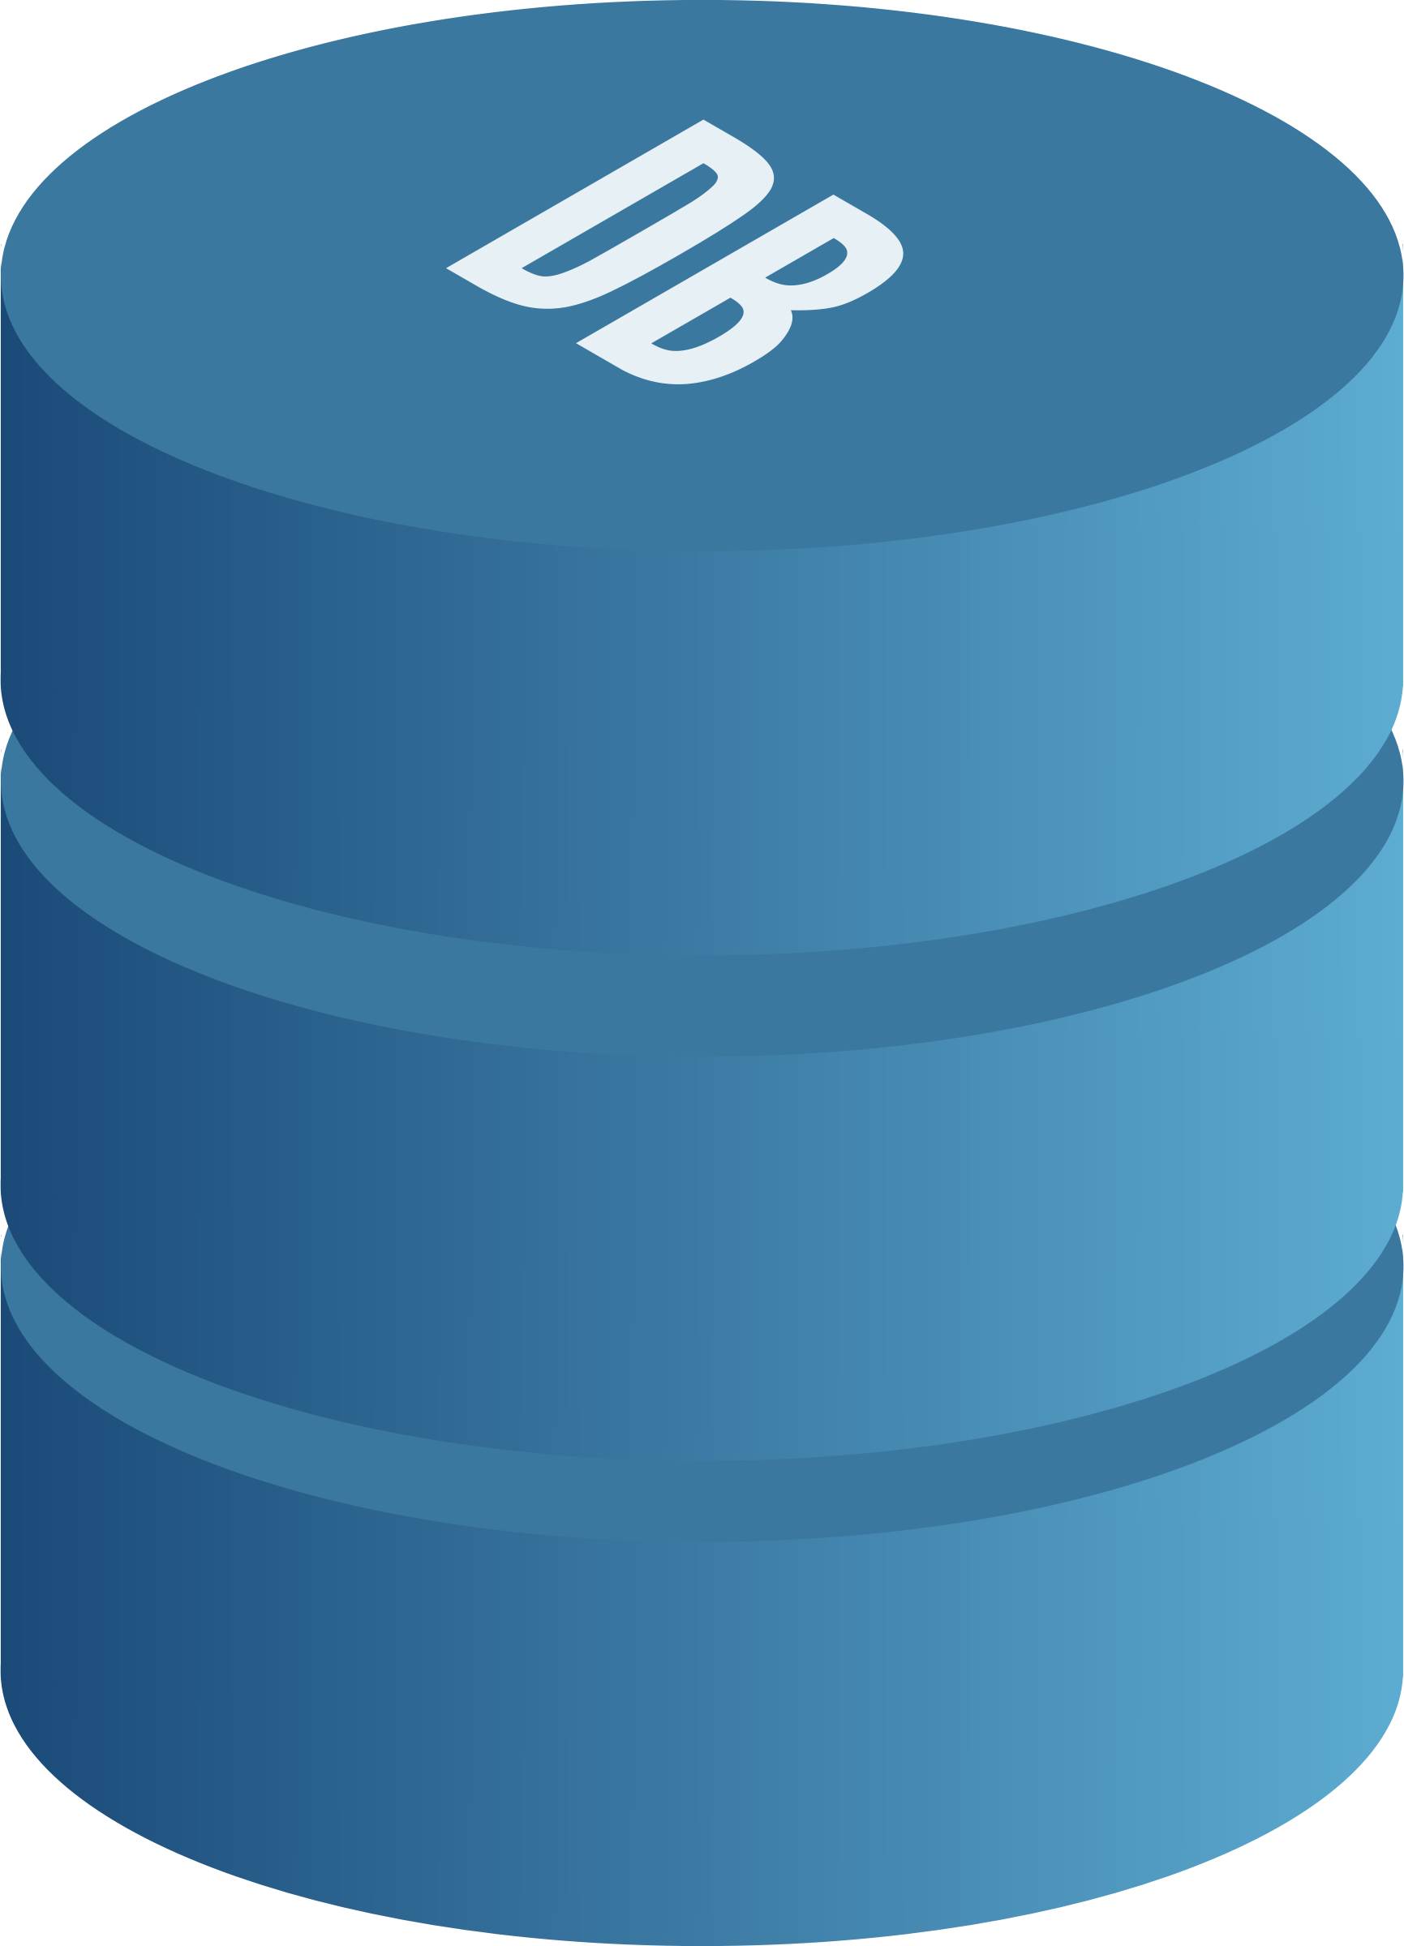
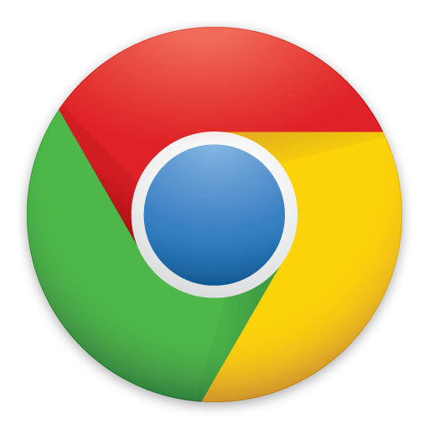



Client - Server Model | 2 - tier Architecture
Presentation Logic
Sending
requests
Data Access Logic
APIs
Services
Business Logic
Sending
responses
HTML, CSS, JS, Web Storage, ...
CLIENT
SERVER

Slide 11
Characteristics | 2 - tier Architecture
Database runs on Server
Separated from client
Easy to switch to a different database
Presentation and logic layers still tightly connected
Heavy load on server
Potential congestion on network (if too many users)
Presentation still tied to business logic

Slide 12
Client - Server Model | 3 - tier Architecture
Presentation Logic
Business Logic
APIs
Services
Data Access Logic
HTML, CSS, JS, Web Storage, HTTP ...
Business Layer
Data Layer
CLIENT
Application SERVER
DB SERVER
Notes:
3-tier Client Server Architecture
Each layer can potentially run on a different machine
Presentation, logic, data layers are decoupled (disconnected)
Architectural Principles
Client - server architecture
Each tier (Presentation, Logic and Data) should be independent and should not expose dependencies related to the implementation
Change in platform affects only the later running on that particular platform
Presentation Layer
Basically the user interface
Handles the interaction with the user
Referred to as GUI or client view or front-end
Should not contain business logic or data access code
Application Logic Layer
The set of rules for processing information
Can accommodate many users
Referred to as middleware/backend
Should not contain presentation or data access code
Data Layer
The physical storage layer for data persistence
Manage access to DB or file system
Referred to as back-end
Should not contain presentation or business logic code
3-tier for Web Apps
Presentation Layer Static or dynamically generated content rendered by the browser (front-end)
Logic Layer A dynamic content processing and generation level application server, e.g., Java EE, ASP.NET, PHP, ColdFusion platform, Node.js & Express.js (middleware)
Data Layer A database, comprising both data sets and the database management system or RDBMS software that manages and provides access to the data (back-end)

Slide 13
Advantages | 3 - tier Architecture
Independence of layers
Easier to maintain
Components are reusable
Faster development (division of work)
Web designer does presentation
Software engineer does logic
DB admin does data model

Slide 14
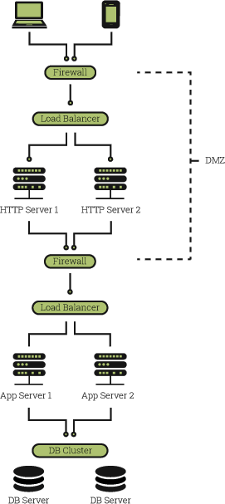
Multi - tier | n - tier Architecture
Interaction between browsers and servers isn’t all there is to a Web application
Web servers themselves operate as ‘clients’ when interacting with other back- end servers, including databases and legacy systems
Architecture of most Web applications is better described as the multi-tier architecture

Slide 15
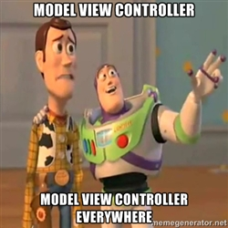
MV* Patterns for Web Apps

Slide 16
Model - View - Controller (MVC) Pattern
Model
View
Manage application behavior and data
Respond to requests for information about its state
Respond to instructions to change state
Expose application functionality
Manage display of information
Request updates from model
Send user interaction events to controller
Controller
Act as an intermediary between models and views
Update model when user manipulates the view
Select & update view to render for response
Update State
Update / Render
Notify State Change
User Action
Notes:
MVC is an architectural design pattern that encourages improved application organization through a separation of concerns. It enforces the isolation of business data (Models) from user interfaces (Views), with a third component (Controllers) traditionally managing logic and user-input.
Relevant Design patterns: MVC may be considered a variation of three classical design patterns: the Observer, Strategy and Composite patterns. Depending on how MVC has been implemented in a framework, it may also use the Factory and Template patterns.

Slide 17
MVC for Web Applications
Model
database tables (persistent data)
session information (current system state data)
rules governing transactions
View
HTML
CSS style sheets
server-side templates (EJS)
Controller
client-side scripting
http request processing
business logic/preprocessing

Slide 18
MVC Pattern Advantages
Separation of Concerns
Clarity of Design
Model methods give an API for data and state
Eases the design of view and controller
Efficient Modularity
Any of the components can be easily replaced
Multiple Views
Many views can be developed as appropriate
Each uses the same API for the model
Easier to Construct and Maintain
Simple (text-based) views while constructing
More views and controllers can be added
Stable interfaces ease development
Distributable
Natural fit with a distributed environment

Slide 19
JavaScript MV* Patterns
Many variations of the MVC pattern are in use today
Model-View-Presenter (MVP) pattern
A derivative of MVC design pattern which focuses on improving presentation logic
Generally used in enterprise-level apps where it's necessary to reuse as much presentation logic as possible.
JS Frameworks using MVP - Backbone.js
Model-View-ViewModel (MVVM)
An architectural pattern based on MVC and MVP, which attempts to more clearly separate user-interfaces (UI) development from that of the business logic and behavior in an app.
JS Frameworks using MVVM - Knockout.js
Other MV* patterns can be seen in many existing JS frameworks
AngularJS, Ember.js, DOJO, YUI, JavaScriptMVC
Good demo examples here: todomvc.com

Slide 20
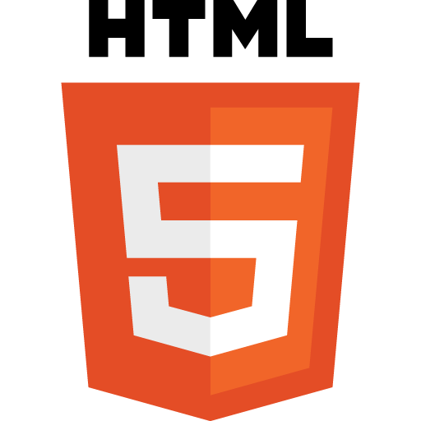
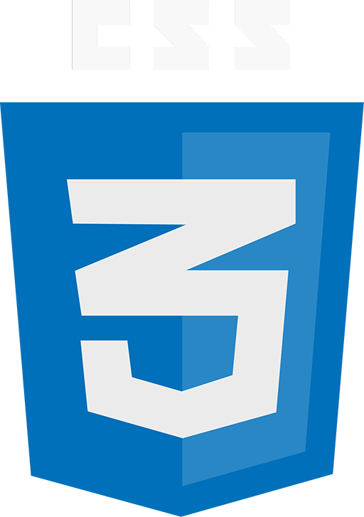

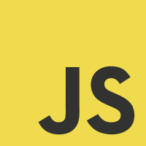
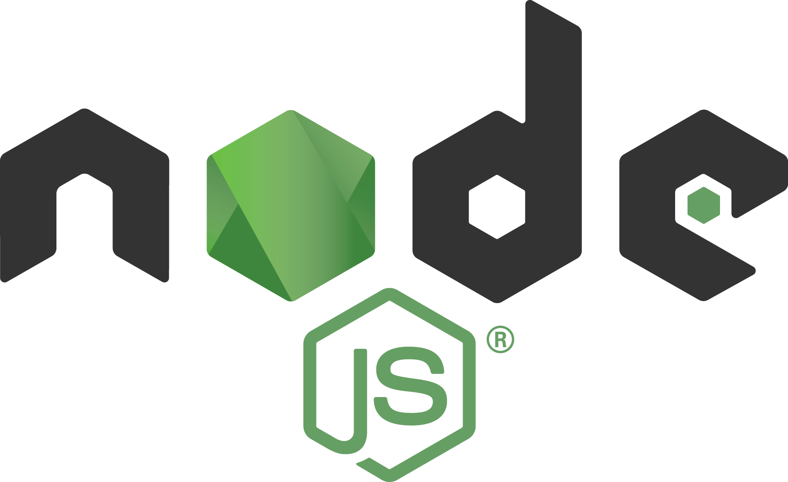


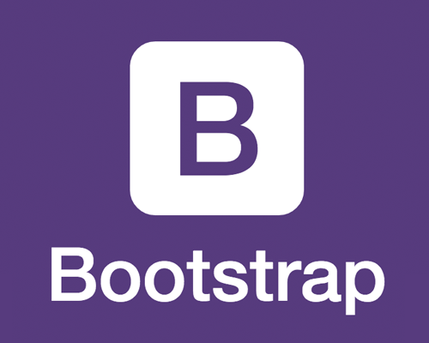



Architectural breakdown & corresponding tech
Client-side / Frontend Technologies
Server-side / Backend Technologies
EJS
. . .
. . .
Frontend Implementation
Backend Implementation, Integration & Hosting

Slide 21
DUE TODAY
Project Teams (please sign up here)
Due Next Week
Project topic and idea
Get familiar with using Git and GitHub
Complete recommended reading for next class
Refer to the corresponding lecture slide
Task Slide

